Slide 1

Product Presentation
Chapter 14 Presenting the Product
Section 14.1 Product Presentation
Section 14.2 Objections

Slide 2
Objections
Objectives
Recognize an objection
Explain the five elements that are common objections
Demonstrate the general four-step method for handling customer objections
List seven specific methods of handling objections and note when each should be used
Marketing Essentials Chapter 14, Section 14.2

Slide 3
If a customer is not ready to Buy
After Presenting the product if the customer says no:
How to Handle in Retail Selling:
be polite and courteously encourage the customer to look around and ask you any questions they may have
Handling In a business-to-business situation
leave a business card
ask if it is possible to see the potential customer at a more convenient time

Slide 4
After presenting the Product, a customer will either say no or may be hesitant to buy. When a customer is hesitant you have an opportunity to change their mind

Slide 5
Understanding Objections
Objections X are concerns, hesitations, doubts, or other reasons a customer has for not making a purchase
Objections can be responded to as either questions/inquiries or statements:
Do you carry any other brands
I already have one like this
Do you have something less expensive
I will have to check with my spouse
I don’t have enough in my budget
Marketing Essentials Chapter 14, Section 14.2

Slide 6
Common Objections
Most objections are based on five key elements:
Need: The customer wants the item but doesn’t need it.
Product: Concerns about quality, size, color, style, etc.
Source: Negative past experiences with a firm or brand.
Price: The product is too expensive.
Time: A hesitation to buy immediately.

Slide 7
To overcome an objection:
Offer a different option
Clarify the features that dispel the objection
Don’t tell them they are wrong, tell them how their thought is false (without saying no or your wrong

Slide 8
Four-Step Process for Handling Objections
It takes four basic steps to handle objections:
Listen
Acknowledge
Restate
Answer

Slide 9
Four-Step Process for Handling Objections
Listening: When listening, remember to:
Be attentive
Maintain eye contact
Let the customer talk
Marketing Essentials Chapter 14, Section 14.2

Slide 10
Four-Step Process for Handling Objections
Acknowledging objections
demonstrates that you understand and care about the customer’s concerns. Some common statements used are:
“I can see your point.”
“Other customers have asked the same question.”
Disagreeing with your customer can put them on the defensive and you risk losing the sale.
Marketing Essentials Chapter 14, Section 14.2

Slide 11
Four-Step Process for Handling Objections
3. Restate:
restate or paraphrase the objections
paraphrase X is to restate something in a different way.
“I can understand your concerns. You feel.... Am I correct?”
“In other words, you feel that....”
Marketing Essentials Chapter 14, Section 14.2

Slide 12
Four-Step Process for Handling Objections
4. Answer each objection tactfully.
Never answer with an air of superiority or suggest that the person’s concern is unimportant.
Marketing Essentials Chapter 14, Section 14.2

Slide 13
Methods to Handling Objections

Slide 14
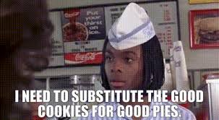
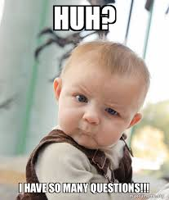
Specialized Methods of Handling Objections
There are SIX specialized methods for handling objections:
Substitution: involves recommending a different product that would satisfy the customer’s needs.
Salesperson I have a red one of those also, would you like to see that
Question: is a technique in which you question the customer about their hesitation.
Customer: When would I ever need a backup battery for my heater?
Salesman: Have you ever come home and your house is colder than when you left?

Slide 15
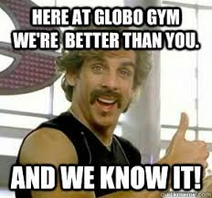
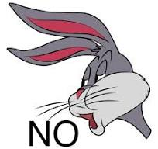
Specialized Methods of Handling Objections
Superior-point: is a technique that permits the salesperson to acknowledge objections as valid, yet still offset them with other features and benefits.
Salesman: Our home security system has the most effective security guards on the market. Our competition doesn’t have the quality we have
Denial: is when the customer’s objection is based on misinformation. You must back up the denial with proof and accurate facts.
There is no way that will go 0 – 60 in 3 seconds
Marketing Essentials Chapter 14, Section 14.2

Slide 16
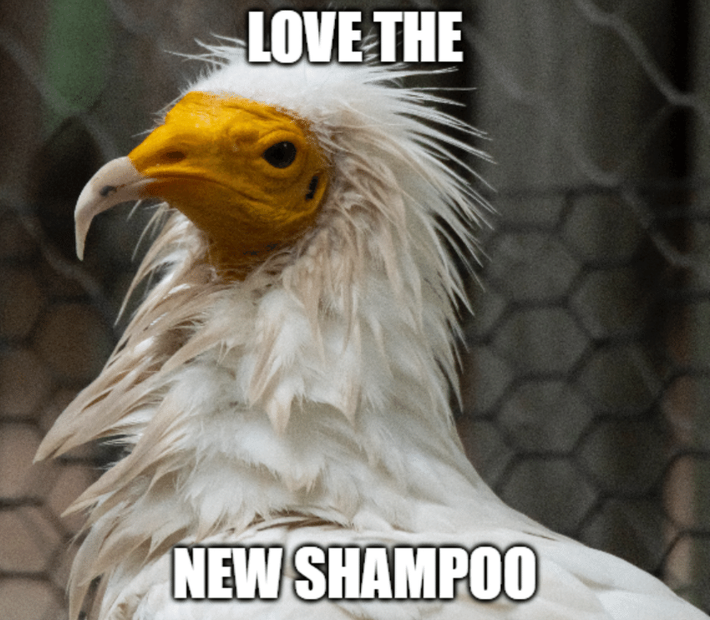
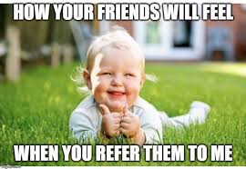
Specialized Methods of Handling Objections
Demonstration: involves showing the features of the product and how it works. Letting the customer do it also
Salesman: Here, let me show you how that vacuum can detect objects and stop on its own.
Third-party: selling method that involves using a previous customer or another neutral person who can give a testimonial about the product.
My pervious customer, Jason Smith, said that this product is so comfortable he would be another in a heart beat.
Marketing Essentials Chapter 14, Section 14.2

Slide 17
Google Classroom Assignment
Divide into groups of 2.
Open the google classroom assignments Handling Objections
Discuss the types of objections and develop a response to overcome each without saying no, or your wrong.

Slide 18
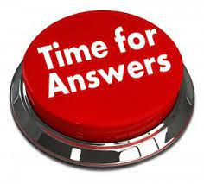
Discuss your answers as a class

